Slide 1
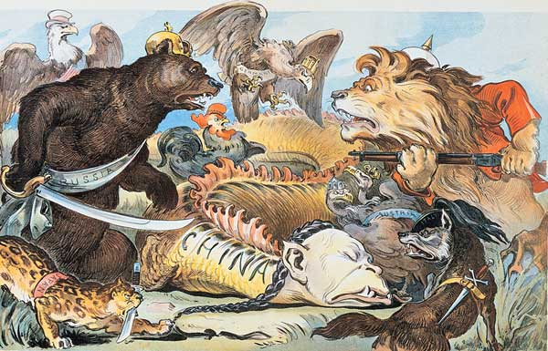
China and Japan Respond to European Imperialism
Comparing Responses
in the 19th Century

Slide 2
Dramatic Moment: The Opium Wars results in the Treaty of Nanjing
After three years of naval warfare(1839-1842), the Treaty of Nanjing is signed in 1842 between Great Britain and the Qing rulers of China
It was the first so-called “unequal treaty”
It opened coastal trading ports to officials, merchants, and missionaries
It also granted “extraterritoriality”—British residents were not subject to Chinese laws.
Treaties with France, Russia, Germany, and the United States followed

Slide 3
Why did the Opium War happen? Why did the Chinese lose?
Event
Political Context
Economic Context
Social /Cultural Context

Slide 4
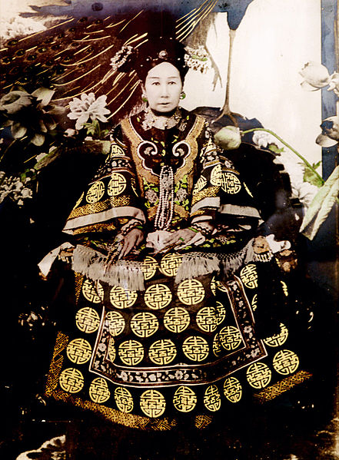
The Political Context
Decline of the Qing Dynasty
Manchu Dynasty—1644-1911)
Empress Dowager Cixi clings to power (retaining her position is her main concern)
Photo Source: http://puyi.netor.com/gallery

Slide 5
Economic Context: Opium
British East India Company develops opium trade from India to south China (1700s)
The BEIC had a royal charter and (eventually) a monopoly on opium which was plentiful in the Bengal region of India (after the British victory in 1757 at the Battle of Plassey)
A commodity to balance the trade of tea, silk and porcelain (instead of paying in silver/gold)
Trade is restricted to (only) the port of Guangzhou
British ideology of free-market capitalism; pressures for more access to ports
1729 | 200 chests of opium/year
1800 | 4,500/year
1838 | 40,000 chests/year

Slide 6
The Qing Ban Opium Imports, 1799
Despite bans, the opium trade continued; in response, the government issued the following decree in 1810:
“Opium has a harm. Opium is a poison, undermining our good customs and morality. Its use is prohibited by law. . . . However, recently the purchasers, eaters, and consumers of opium have become numerous.
Deceitful merchants buy and sell it to gain profit. The customs house at the Ch'ung-wen Gate was originally set up to supervise the collection of imports (it had no responsibility with regard to opium smuggling). If we confine our search for opium to the seaports, we fear the search will not be sufficiently thorough. We should also order the general commandant of the police and police- censors at the five gates to prohibit opium and to search for it at all gates.
If they capture any violators, they should immediately punish them and should destroy the opium at once. As to Kwangtung and Fukien the provinces from which opium comes, we order their viceroys, governors, and superintendents of the maritime customs to conduct a thorough search for opium, and cut off its supply. They should in no ways consider this order a dead letter and allow opium to be smuggled out!

Slide 7
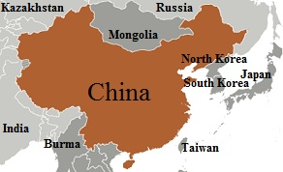
Cultural Context
Chinese attitudes
Confucian beliefs hold merchants in low esteem
Superiority
Belief that they are the “Middle Kingdom”
Consider all foreigners “barbarians”
Trade was through the “tributary system”—which forced all nations to “kowtow” and pay tribute in order to be granted trading privileges

Slide 8
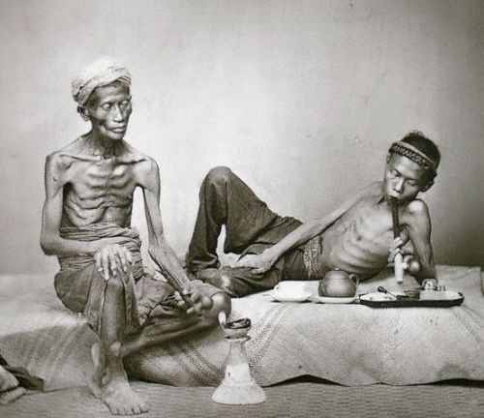
Social Context
Huge number of Chinese people become addicted to opium
The emperor appoints Lin Zexu “imperial commissioner for trade” in the 1830s
Restricts imports (1729)
Provides services to rehabilitate addicts
Tries to confiscate and destroy opium, 1838
1839, he publishes an open letter to Queen Victoria
http://www.environmentalgraffiti.com/history/news-incredible-images-19
Photo Source: http://www.environmentalgraffiti.com/history/news-incredible-images-19th-century-opium-dens
Notes:
Wikipedia Notes:
In 1834 to accommodate the revocation of the East India Company's monopoly, the British sent Lord William John Napier to Macau. He tried to circumvent the restrictive Canton Trade laws which forbade direct contact with Chinese officials by attempting to send a letter directly to the Viceroy of Canton. The Viceroy refused to accept it, and closed trade starting on 2 September of that year. Lord Napier had to return to Macau (where he died a few days later) and, unable to force the matter, the British agreed to resume trade under the old restrictions.
Within the Chinese mandarinate there was an ongoing debate over legalising the opium trade itself. Even the Emperor at the time, a teenager who spent most of his time in bed with his concubine, Cixi, was a user of the drug. However, legalization was repeatedly rejected, and in 1838 the government sentenced native drug traffickers to death. Around this time, the British were selling roughly 1,400 tons per year to China. In March 1839, the Emperor appointed a new strict Confucian commissioner, Lin Zexu, to control the opium trade at the port of Canton.^{[25]}
His first course of action was to enforce the imperial demand that there be a permanent halt to drug shipments into China. When the British refused to end the trade, Lin blockaded the British traders in their factories and cut off supplies of food.^{[26]} On 27 March 1839 Charles Elliot, British Superintendent of Trade—who had been locked in the factories when he arrived at Canton—finally agreed that all British subjects should turn over their opium to him, amounting to nearly a year's supply of the drug, to be confiscated by Commissioner Lin Zexu. In a departure from his brief, he promised that the crown would compensate them for the lost opium.
While this amounted to a tacit acknowledgment that the British government did not disapprove of the trade, it also forced a huge liability on the exchequer. Unable to allocate funds for an illegal drug but pressed for compensation by the merchants, this liability is cited as one reason for the decision to force a war.^{[27]}
As well as seizing supplies in the factories, Chinese troops boarded British ships in international waters outside Chinese jurisdiction, where their cargo was still legal, and destroyed the opium aboard. After the opium was surrendered, trade was restarted on the strict condition that no more drugs would be smuggled into China. Lin demanded that British merchants sign a bond promising not to deal in opium, under penalty of death.^{[28]} The British officially opposed signing of the bond, but some British merchants that did not deal in opium were willing to sign. Lin had the opium disposed of by dissolving it in water, salt, and lime, and dumping it into the ocean.
In 1839, Lin took the step of publishing a letter addressed to Queen Victoria questioning the moral reasoning of the British government (it is not known that she ever received it). Citing what he understood to be a strict prohibition of the trade within Great Britain, Lin questioned how it could then profit from the drug in China. He wrote: "Your Majesty has not before been thus officially notified, and you may plead ignorance of the severity of our laws, but I now give my assurance that we mean to cut this harmful drug forever."^{[29]}
In fact, opium was not illegal in England at the time, and comparably smaller quantities were imported. The British government and merchants offered no response to Lin, accusing him instead of destroying their property. When the British learned of what was taking place in Canton, as communications between these two parts of the world took months at this time, they sent a large British Indian army, which arrived in June 1840.^{[30]}
British military superiority drew on newly applied technology. British warships wreaked havoc on coastal towns; the steam ship Nemesis was able to move against the winds and tides and support a gun platform with very heavy guns. In addition, the British troops were the first to be armed with modern muskets and cannons, which fired more rapidly and with greater accuracy than the Qing firearms and artillery, though Chinese cannons had been in use since previous dynasties. After the British took Canton, they sailed up the Yangtzeand took the tax barges, a devastating blow to the Empire as it slashed the revenue of the imperial court in Beijing to just a fraction of what it had been.
In 1842, the Qing authorities sued for peace, which concluded with the Treaty of Nanking negotiated in August of that year and ratified in 1843. In the treaty, China was forced to pay an indemnity to Britain, open four ports to Britain, and cede Hong Kong to Queen Victoria. In the supplementary Treaty of the Bogue, the Qing empire also recognised Britain as an equal to China and gave British subjects extraterritorial privileges in treaty ports. In 1844, the United States and France concluded similar treaties with China, the Treaty of Wanghia and Treaty of Whampoa respectively.
The First Opium War was attacked in the House of Commons by a newly elected young member of Parliament, William Ewart Gladstone, who wondered if there had ever been "a war more unjust in its origin, a war more calculated to cover this country with permanent disgrace, I do not know."^{[31]}
The Foreign Secretary, Lord Palmerston, replied by saying that nobody could "say that he honestly believed the motive of the Chinese Government to have been the promotion of moral habits" and that the war was being fought to stem China's balance of payments deficit. John Quincy Adams commented that opium was "a mere incident to the dispute... the cause of the war is the kowtow—the arrogant and insupportable pretensions of China that she will hold commercial intercourse with the rest of mankind not upon terms of equal reciprocity, but upon the insulting and degrading forms of the relations between lord and vassal."^{[32]}

Slide 9
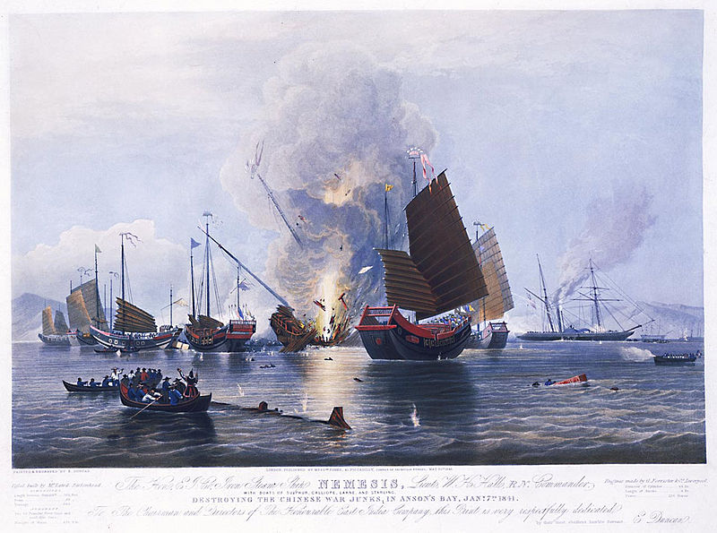
Military Context
The East India Company iron steam ship Nemesis, commanded by Lieutenant W. H. Hall, with boats from the Sulphur, Calliope, Larne and Starling, destroying the Chinese war junks in Anson's Bay, on 7 January 1841 Source: http://ocw.mit.edu/ans7870/21f/21f.027/opium_wars_01/ow1_gallery/pages/1841_0792_nemesis_jm_nmm.htm

Slide 10
Effects of Opium War & Treaty of Nanjing
Internal Unrest
Taiping Rebellion (1850s-1870s)
Leader: Hong Xiu-quan
Claimed to see visions of Jesus’ brother; Prophesized a heavenly kingdom in China
Revolt plays on discontent with corruption, inability to resist foreigners.
Though eventually put down, this rebellion showed how ineffective the Qing army was
Continued External Pressure
Second Opium Wars (1850s) opens more ports to British and French
Unequal Treaties
“Century of Humiliation”
Spheres of Influence/Foreign Footholds
1884 French defeat China to take control of Vietnam
1894-5 China loses Korean in the Sino-Japanese War
Russia encroaches on Manchuria

Slide 11
How should China respond?
Reform (1870s-80s)
Modernize the army and weapons; translate Western books
(Again in 1895) Modernize educational system
Self-Strengthening
Boxer Rebellion (1900)
Revolution
New China Movement
Sun Yat Sen (Kuomindang—Nationalist Party)
May Fourth Movement

Slide 12
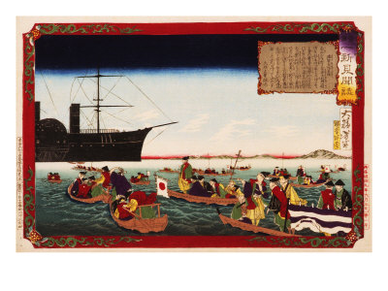
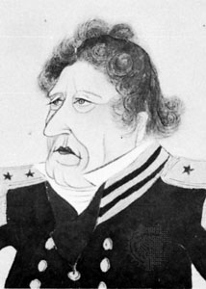
1853: Matthew Perry demands Japan “open” its country to foreigners and trade
How should Japan have responded? How did they respond?
Notes:
CHINA
Opium War (First, 1838-42) (Second, 1856-60)
Chinese response to the continued European smuggling of Opium into their country led to this war of self-defense.
Boxer Rebellion
A rebellion that broke out in 1900 and surrounded and laid siege to European section of Beijing.
Open Door Policy
the policy of forcing China to grant equal trade opportunities to all countries that want it. It prevented China from being carved into colonies but still left her largely at the mercy of foreign powers.
JAPAN
Meiji Restoration
The period from 1868-1912 that marked the reign of the Emperor Meiji ("enlightened rule") as his reign name. The restoration brought western ideas to keep westerners out.
Sphere of Influence
a territorial area over which political or economic influence is wielded by one nation.

